Slide 1
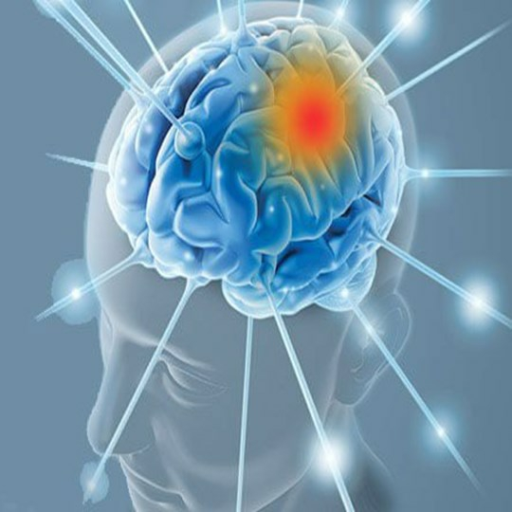
Brain Tumor Detection From MRI Images With IBM Watson Studio

Slide 2


TEAM MEMBERS
P.Ashritha(18UK1A05L5)
K.Susmitha(18UK1A05F0)
S.Chandana(18UK1A05N1)
M.Shakil UR Rahman(18UK1A05L1)

Slide 3
CONTENTS
Abstract
Introduction
About brain tumor
Black diagram
Types
Segmentation
Advantages
Applications

Slide 4
ABSTRACT
A Brain tumor is considered as one of the aggressive diseases, among children and adults. Brain tumors account for 85 to 90 percent of all primary Central Nervous System(CNS) tumors. Every year, around 11,700 people are diagnosed with a brain tumor. The 5-year survival rate for people with a cancerous brain or CNS tumor is approximately 34 percent for men and36 percent for women. Brain Tumors are classified as: Benign Tumor, Malignant Tumor, Pituitary Tumor, etc. Proper treatment, planning, and accurate diagnostics should be implemented to improve the life expectancy of the patients. The best technique to detect brain tumors is Magnetic Resonance Imaging (MRI). A huge amount of image data is generated through the scans. These images are examined by the radiologist. A manual examination can be error-prone due to the level of complexities involved in brain tumors and their properties.
Application of automated classification techniques using Machine Learning(ML) and Artificial Intelligence(AI)has consistently shown higher accuracy than manual classification. Hence, proposing a system performing detection and classification by using Deep Learning Algorithms using ConvolutionNeural Network (CNN), Artificial Neural Network (ANN), and TransferLearning (TL) would be helpful to doctors all around the world.

Slide 5
INTRODUCTION
→ Brain tumor is one of the vital organs in the human body. Its consists of billions of cells.
→ The obnormal gruop cell is formed from the uncontroled division of cells.Which is also called as tumor.
→ Brain MRI image is mainly used to detect to the tumor and tumor progress modelling process.
→ This information is mainly used for tumur detection and reatement processes.
→ MRI image provides detailed information about brain structure and anomaly detection in brain tissue.

Slide 6
About The Brain Tumor
Brain tumor is a collection or mass of obnormal cells in your brain.
This occurs because the normal metabolisum of cells stop. Some cells may not die and new cells will grow.
The brain tumor can be mainly divieded into two primary brain tumor and metastatic brain tumor.

Slide 7
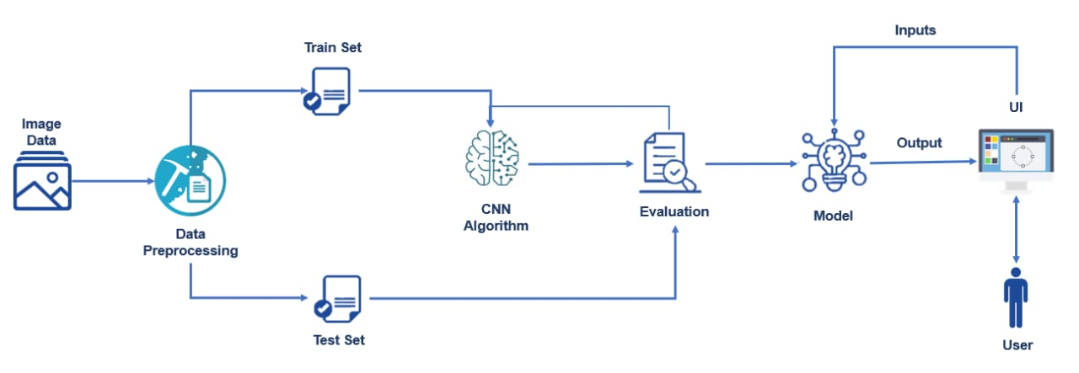
Black Diagram

Slide 8
Types Of Brain Tumor
Brian tumor divieded into two types
1.Low grade tumor(grade1 and grade2)
Low grade brain tumor is called as benign.
benign tumor is not cancerous tumor.
Hence it deos not spread other parts of the brains.
2.Highgrade tumor (grade3 and grade4)
The highgrade tumor is also known as malignant.
The malignant is a cancerous tumor.
So it spreads rapiedlly with indefinate boundaries to other region of the
body easly.
It leads ti immidiate death.

Slide 9
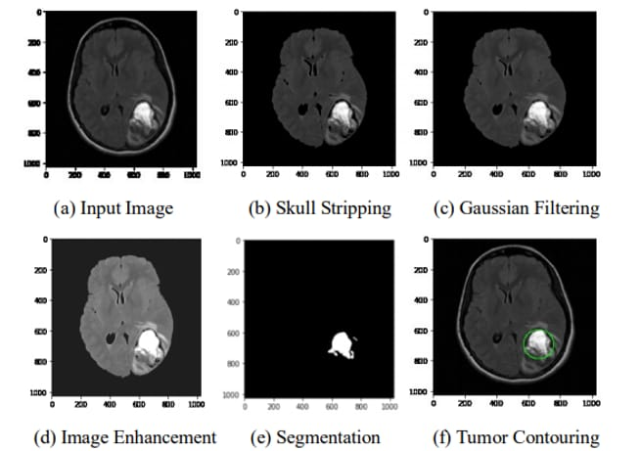
Segmentation Processes Of An MRI

Slide 10
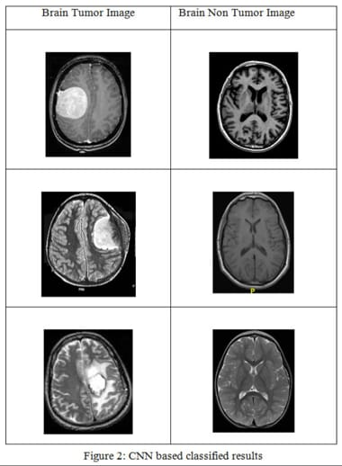
Deceased And Non-Deceased Brain

Slide 11
Advantages
It can segment the brain region from the image occurately.
It is useful to classify the brain tumor images for accurate detection.
Brain tumor will be detected in an early stages.

Slide 12
Applications
The main aim of the application is tumor identification.
The main reason behand the development of this application is to provide proper treatement as soon as possible and protect the human life which is in danger.
This application is helpful to docters as well as patient.
The manual identification is not fast, accuarate and efficient, to overcome whose problem this application s design.
It is user friendly application.

Slide 13

Treatment Options Of Brain Tumor
Surgery
Radiation therapy
Stereotactic radiosurgery
Chemotherapy
Targeted drug therapy

Slide 14
THANK YOU

